Slide 1
Machine Learning
MATH42815
Friday February 2nd 2024

Slide 2
Week 4
Practical 10:
Neural Networks
Lecture 7:
POSTPONED DUE TO BEREAVEMENT
Practicals 11 and 12:
Neural Networks
Lecture “8”:
Neural Networks 2
Lecture “9”: (Tuesday of Week 5)
Catch-up, Q&A, Assignment 2 questions

Slide 3
Lecture 7 “8” Outline
Perceptrons
Back Propagation – Workshop 10 example
Saddle Points
Thresholds and Bias
Performance Metrics
Choosing Starting Weights
Convolutional Neural Networks
Dropout
Autoencoders
You Are All Models

Slide 4
Perceptrons

Slide 5
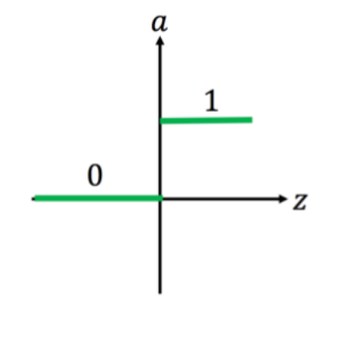
Perceptrons
Binary output – TRUE or FALSE, 1 or 0, something did or didn’t happen
Affine Transformation:
Multiply feature variables x_{j} by weights w_{j}
Sum over j
Activation function:
If result of affine transformation is greater than some minimum (“threshold” = -b) value, output is 1 / TRUE / the thing happened
Otherwise output is 0
This represents step function – can use sigmoids etc. to calculate probabilities instead of binary step
Step happens at 0 if you include +b in affine transformation sum

Slide 6
Train Your Perceptron
Have set of observations of feature variables x_{i} and response variable y_{i}
In Spongebob example, all four feature variables also binary
In house price example, feature variables were numeric
Needed to be scaled – in this instance, used range (0,1) rather than converting to standard normal
Define your loss function (more on this later!)
Change your values of w and b to decrease the value of the loss function
Back Propagation!

Slide 7
Back Propagation

Slide 8
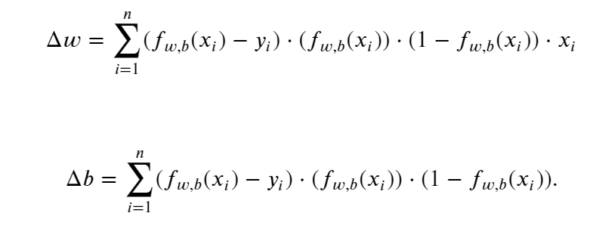
Workshop 10

Slide 9
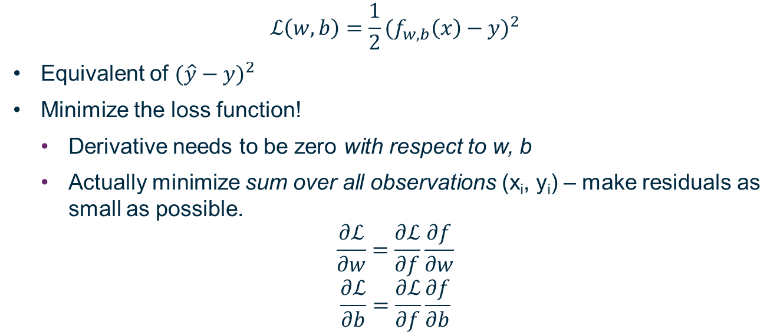
Loss Function
$$ℒ\left(w,b\right)=\frac{1}{2}{(f_{w,b}\left(x\right)−y)}^{2}$$
Equivalent of ${(\hat{y}−y)}^{2}$
Minimize the loss function!
Derivative needs to be zero with respect to w, b
Actually minimize sum over all observations (x_{i}, y_{i}) – make residuals as small as possible.
$$\frac{∂ℒ}{∂w}=\frac{∂ℒ}{∂f}\frac{∂f}{∂w}$$
$$\frac{∂ℒ}{∂b}=\frac{∂ℒ}{∂f}\frac{∂f}{∂b}$$

Slide 10

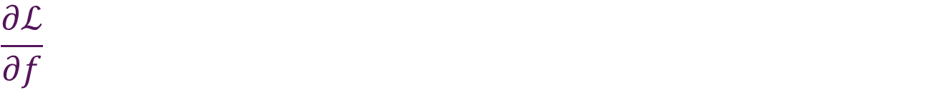
$$\frac{∂ℒ}{∂f}$$
$$ℒ\left(w,b\right)=\frac{1}{2}{(f_{w,b}\left(x\right)−y)}^{2}=\frac{1}{2}u^{2}$$
$${u=f}_{w,b}\left(x\right)−y$$
$$\frac{∂ℒ}{∂f}=\frac{∂ℒ}{∂u}\frac{∂u}{∂f}=u∙1={u=f}_{w,b}\left(x\right)−y$$

Slide 11

Workshop 10 Activation Function
$$f_{w,b}\left(x\right)=\frac{1}{1+exp⁡(−wx+b)}=\frac{1}{p}$$
$$p= 1+\exp\left(−wx+b\right)=1+q$$
$$q=\exp\left(−wx+b\right)=exp(r)$$
$$r=−wx+b$$

Slide 12
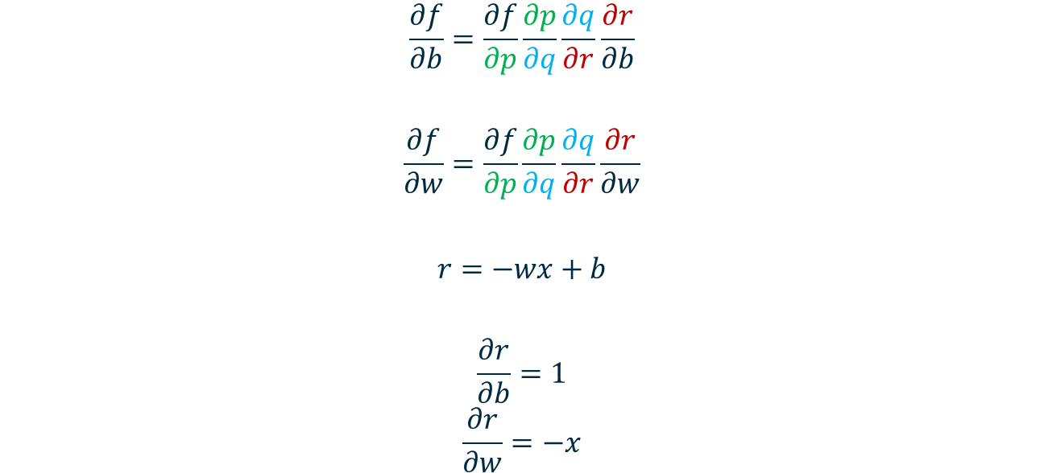
Derivative w.r.t. b and w
$$\frac{∂f}{∂b}=\frac{∂f}{∂p}\frac{∂p}{∂q}\frac{∂q}{∂r}\frac{∂r}{∂b}$$
$$\frac{∂f}{∂w}=\frac{∂f}{∂p}\frac{∂p}{∂q}\frac{∂q}{∂r}\frac{∂r}{∂w}$$
$$r=−wx+b$$
$$\frac{∂r}{∂b}=1$$
$$\frac{∂r}{∂w}=−x$$

Slide 13
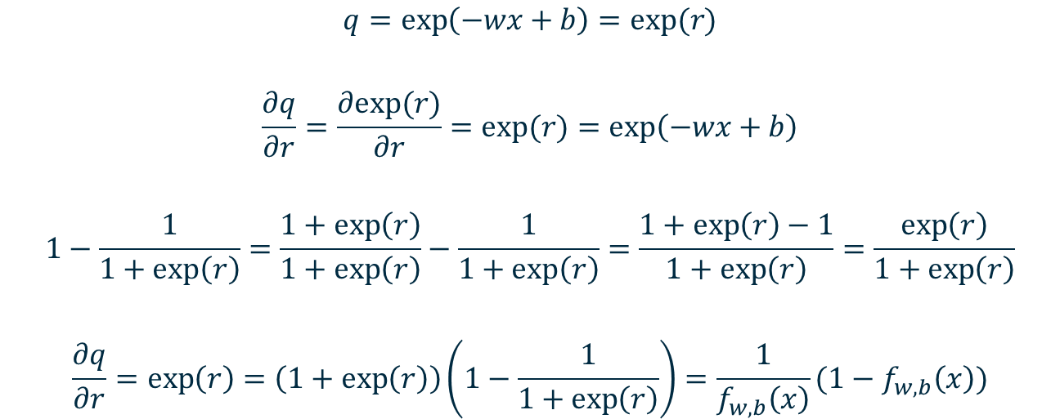
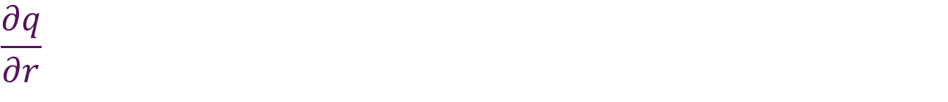
$$\frac{∂q}{∂r}$$
$$q=\exp\left(−wx+b\right)=exp(r)$$
$$\frac{∂q}{∂r}=\frac{∂exp⁡(r)}{∂r}=exp⁡(r)=\exp\left(−wx+b\right)$$
$$1−\frac{1}{1+\exp\left(r\right)}=\frac{1+\exp\left(r\right)}{1+\exp\left(r\right)}−\frac{1}{1+\exp\left(r\right)}=\frac{1+\exp\left(r\right)−1}{1+\exp\left(r\right)}=\frac{\exp\left(r\right)}{1+\exp\left(r\right)}$$
$$\frac{∂q}{∂r}=\exp\left(r\right)=\left(1+\exp\left(r\right)\right)\left(1−\frac{1}{1+\exp\left(r\right)}\right)=\frac{1}{f_{w,b}\left(x\right)}(1−f_{w,b}\left(x\right))$$

Slide 14

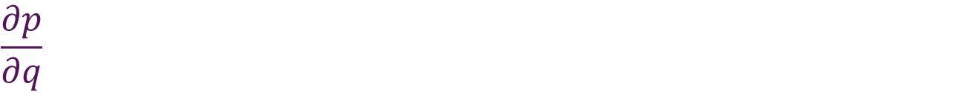
$$\frac{∂p}{∂q}$$
$$p= 1+q$$
$$\frac{∂p}{∂q}=1$$

Slide 15

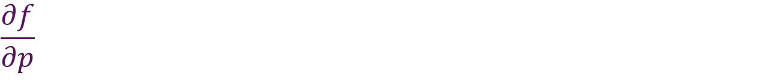
$$\frac{∂f}{∂p}$$
$$f_{w,b}\left(x\right)=\frac{1}{p}=p^{−1}$$
$$\frac{∂f_{w,b}}{∂p}=\frac{∂p^{−1}}{∂p}=−p^{−2}=−f_{w,b}^{2}$$

Slide 16
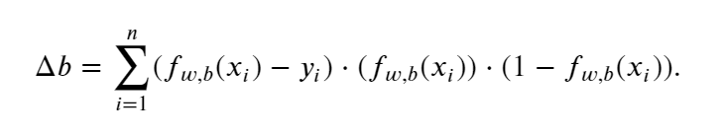

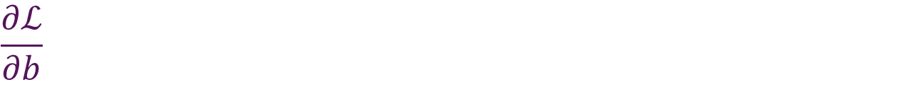
$$\frac{∂ℒ}{∂b}$$
$$\frac{∂ℒ}{∂b}=\frac{∂ℒ}{∂f}\frac{∂f}{∂p}\frac{∂p}{∂q}\frac{∂q}{∂r}\frac{∂r}{∂b}$$
$$\frac{∂ℒ}{∂b}=(f_{w,b}\left(x\right)−y)∙(−f_{w,b}^{2})∙1∙\frac{1}{f_{w,b}}(1−f_{w,b})∙1$$
$$=(f_{w,b}\left(x\right)−y)∙({−f}_{w,b})∙ (1−f_{w,b})$$

Slide 17
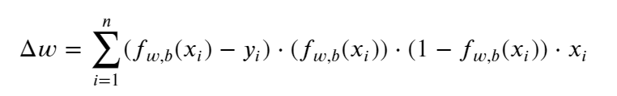


$$\frac{∂ℒ}{∂w}$$
$$\frac{∂ℒ}{∂w}=\frac{∂ℒ}{∂f}\frac{∂f}{∂p}\frac{∂p}{∂q}\frac{∂q}{∂r}\frac{∂r}{∂w}$$
$$\frac{∂ℒ}{∂w}=(f_{w,b}\left(x\right)−y)∙(−f_{w,b}^{2})∙1∙\frac{1}{f_{w,b}}(1−f_{w,b})∙x$$
$$=(f_{w,b}\left(x\right)−y)∙({−f}_{w,b})∙ (1−f_{w,b})∙x$$

Slide 18
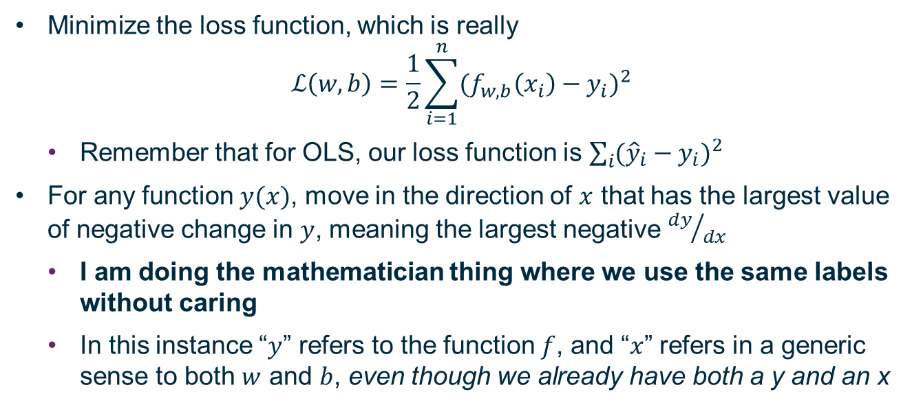
Gradient Descent
Minimize the loss function, which is really
$$ℒ\left(w,b\right)=\frac{1}{2}\sum_{i=1}^{n}{{(f_{w,b}\left(x_{i}\right)−y_{i})}^{2}}$$
Remember that for OLS, our loss function is $\sum_{i}{{({\hat{y}}_{i}−y_{i})}^{2}}$
For any function $y(x)$, move in the direction of $x$ that has the largest value of negative change in $y$, meaning the largest negative ${dy}/{dx}$
I am doing the mathematician thing where we use the same labels without caring
In this instance “$y$” refers to the function $f$, and “$x$” refers in a generic sense to both $w$ and $b$, even though we already have both a y and an x

Slide 19
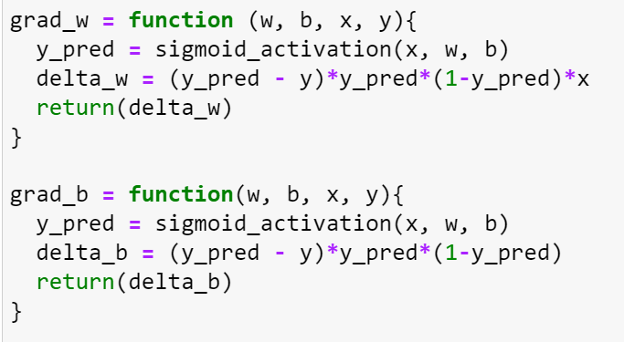

Workshop 10 code
y_pred = $f_{w,b}\left(x\right)$

Slide 20
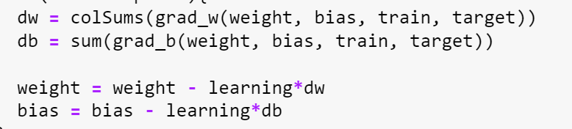
Implementing the Algorithm
There is one w_{j} for each feature variable, and that w_{j} is shifted based on the residual in the X_{j} dimension of the feature hyperspace
There is one b overall, and that is shifted based on the “residual of the intercept”
Can also think about the first column of the design matrix – everything set to 1, can include a neuron that always gets passed 1 whose weight will be b

Slide 21
Why Didn’t We Discuss This Sooner?
This neural network only has one set of weights
The complicated mathematics I briefly displayed last week involves passing through multiple sets of weights and activation functions
This is an excellent example of a semi-complicated loss function in a straightforward neural network
For Tuesday, one of the things I’m planning to prepare is an equivalent explanation for the XOR neural network that we discussed in Lecture 6
This will use two sets of weights and an activation function – still straightforward, but should add a degree of complexity beyond what is shown here

Slide 22
Saddle Points

Slide 23
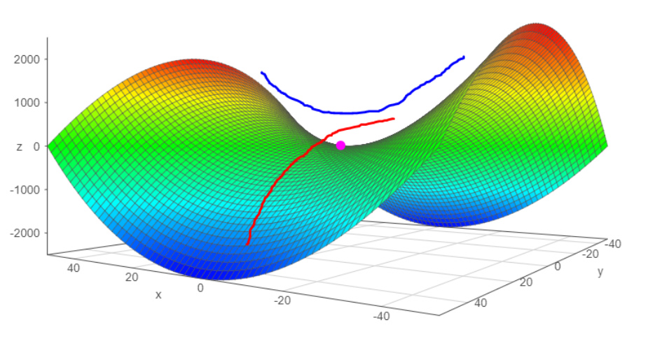
Saddle Points – Gradient is Zero, but Loss Function not Minimum!
Hailiang Du

Slide 24
Thresholds and Bias

Slide 25
Threshold
Most of our non-linear activation functions are composed of two connected linear functions
This is not a requirement, but it makes life simpler
Step function: 0 or 1, change at “threshold” = -bias
Discontinuity at threshold
Sigmoid: 0, 1, or some value in between
Location of change determined by bias b
Steepness of change in direction x_{j} determined by weight w_{j}
RELU: 0 or x, change at 0 (if bias term +b included in previous layer) or –b
Activation function for regression

Slide 26
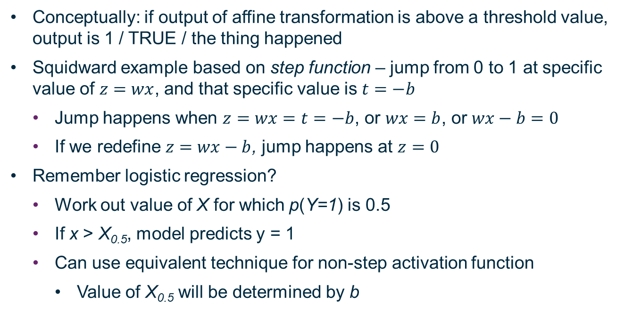
Perceptrons: Threshold
Conceptually: if output of affine transformation is above a threshold value, output is 1 / TRUE / the thing happened
Squidward example based on step function – jump from 0 to 1 at specific value of $z=wx$, and that specific value is $t=−b$
Jump happens when $z=wx=t=−b$, or $wx=b$, or $wx−b=0$
If we redefine $z=wx−b$, jump happens at $z=0$
Remember logistic regression?
Work out value of X for which p(Y=1) is 0.5
If x > X_{0.5}, model predicts y = 1
Can use equivalent technique for non-step activation function
Value of X_{0.5} will be determined by b

Slide 27
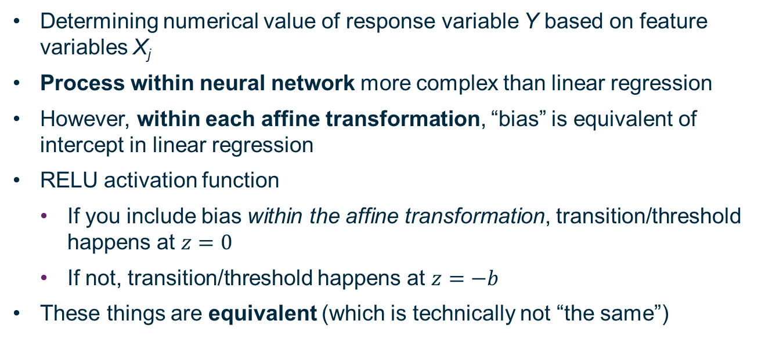
Regression: Bias
Determining numerical value of response variable Y based on feature variables X_{j}
Process within neural network more complex than linear regression
However, within each affine transformation, “bias” is equivalent of intercept in linear regression
RELU activation function
If you include bias within the affine transformation, transition/threshold happens at $z=0$
If not, transition/threshold happens at $z=−b$
These things are equivalent (which is technically not “the same”)

Slide 28
Performance Metrics

Slide 29
Train Your Perceptron
Have set of observations of feature variables x_{i} and response variable y_{i}
In Spongebob example, all four feature variables also binary
In house price example, feature variables were numeric
Needed to be scaled – in this instance, used range (0,1) rather than converting to standard normal
Define your loss function (more on this later now!)
Technically these are objective functions because we want maxima
For more details, see Chapter 11 of Deep Learning by Goodfellow et al.

Slide 30
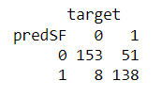
Confusion Matrix
Specifically showing binary output here
This all extends to many categories
 | Observation: - | Observation: +
Model: - | True Negative | False Negative
Model: + | False Positive | True Positive
 | Observation: + | Observation: -
Model: + | True Positive | False Positive
Model: - | False Negative | True Negative
 | Observation: + | Observation: -
Model: + | True Positive | False Positive
Model: - | False Negative | True Negative
 | Observation: TRUE | Observation: FALSE
Model: TRUE | True Positive | False Positive
Model: FALSE | False Negative | True Negative

Slide 31
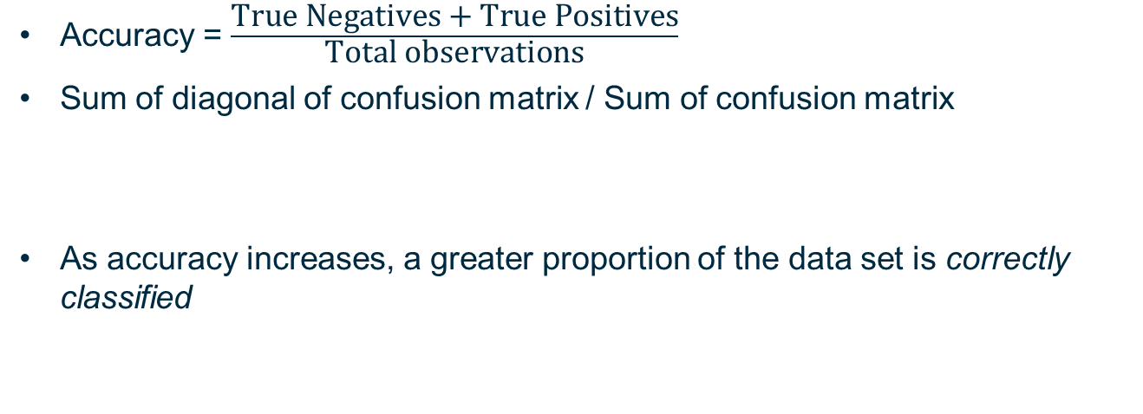
Default Metric: Accuracy
Accuracy = $\frac{\text{True} \text{Negatives}\text{ + }\text{True} \text{Positives}}{\text{Total} \text{observations}}$
Sum of diagonal of confusion matrix / Sum of confusion matrix
As accuracy increases, a greater proportion of the data set is correctly classified

Slide 32
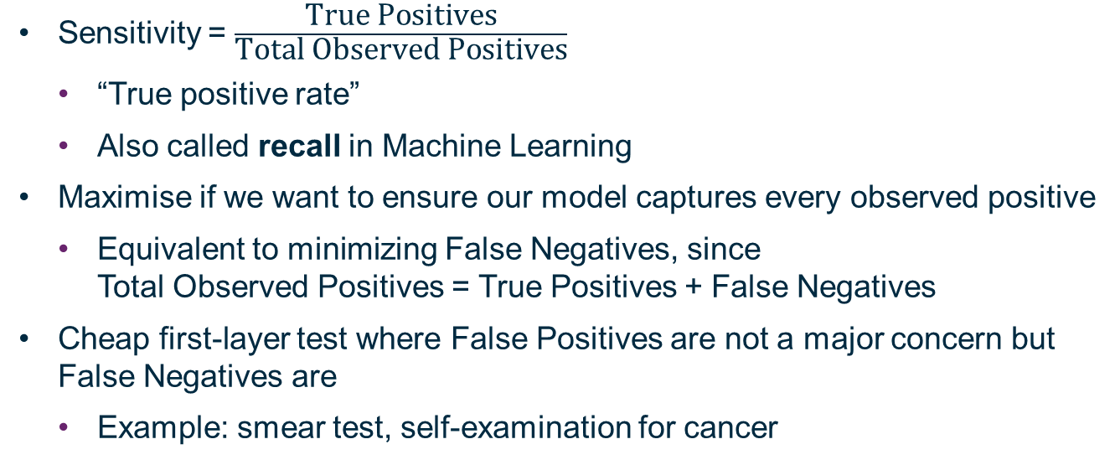
Sensitivity
Sensitivity = $\frac{\text{True} \text{Positives}}{\text{Total} \text{Observed} \text{Positives}}$
“True positive rate”
Also called recall in Machine Learning
Maximise if we want to ensure our model captures every observed positive
Equivalent to minimizing False Negatives, since Total Observed Positives = True Positives + False Negatives
Cheap first-layer test where False Positives are not a major concern but False Negatives are
Example: smear test, self-examination for cancer
[,2]

Slide 33
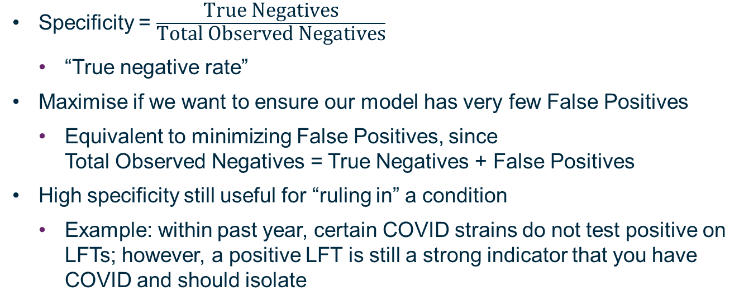
Specificity
Specificity = $\frac{\text{True} \text{Negatives}}{\text{Total} \text{Observed} \text{Negatives}}$
“True negative rate”
Maximise if we want to ensure our model has very few False Positives
Equivalent to minimizing False Positives, since Total Observed Negatives = True Negatives + False Positives
High specificity still useful for “ruling in” a condition
Example: within past year, certain COVID strains do not test positive on LFTs; however, a positive LFT is still a strong indicator that you have COVID and should isolate
[,1]

Slide 34
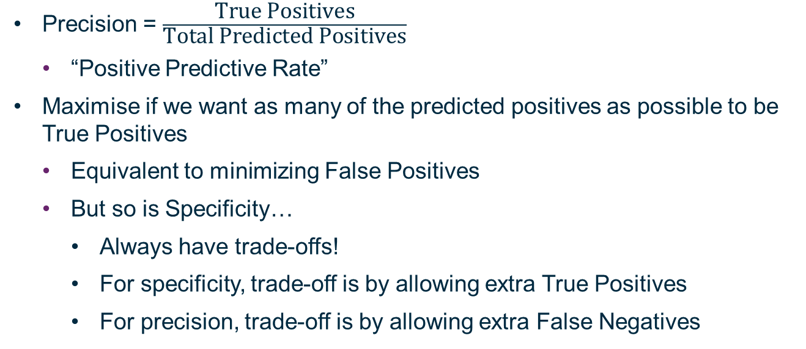
Precision
Precision = $\frac{\text{True} \text{Positives}}{\text{Total} \text{Predicted} \text{Positives}}$
“Positive Predictive Rate”
Maximise if we want as many of the predicted positives as possible to be True Positives
Equivalent to minimizing False Positives
But so is Specificity…
Always have trade-offs!
For specificity, trade-off is by allowing extra True Positives
For precision, trade-off is by allowing extra False Negatives

Slide 35
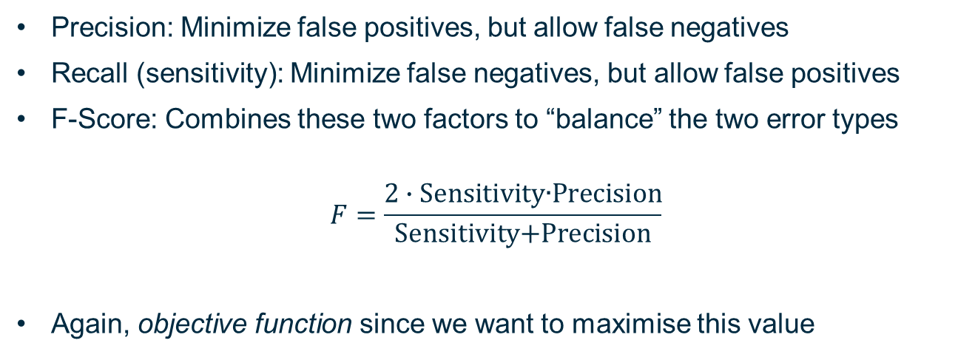
F-Score
Precision: Minimize false positives, but allow false negatives
Recall (sensitivity): Minimize false negatives, but allow false positives
F-Score: Combines these two factors to “balance” the two error types
$$F=\frac{2∙\text{Sensitivity}\text{∙}\text{Precision}}{\text{Sensitivity}\text{+}\text{Precision}}$$
Again, objective function since we want to maximise this value

Slide 36
Coverage
Example: Google Street View transcribes addresses if it thinks it can do so at an equivalent accuracy to a human
Human transcription accuracy: 98%
Much “easier” for humans to let computer do transcription, but only “useful” if transcription is accurate
Remember how all models are wrong and some are useful?
Model can estimate whether it thinks its transcription is correct, and if it is less confident than some chosen hyperparameter, it tells a human to do it
If it always tells the human to do it, the computer’s accuracy will be 100%
…of the 0% of the work it did
“Coverage”: Proportion of work a computer did to “sufficient” accuracy

Slide 37
No Exact Equivalent for Regression
With regression model, will be looking at difference between predicted value and observed value to determine loss function
Not just “mis-classified” values
Might consider using perpendicular distance in data hyper-space instead of response-variable residuals
Point of using response-variable residuals is that have a causal link
Might think differently for unsupervised learning

Slide 38
Choosing Starting Weights

Slide 39
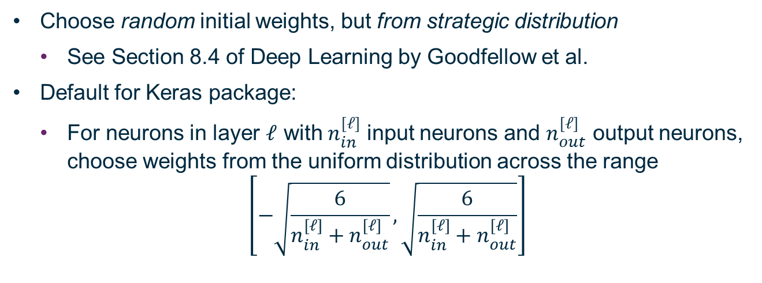
Selecting Initial Values
Choose random initial weights, but from strategic distribution
See Section 8.4 of Deep Learning by Goodfellow et al.
Default for Keras package:
For neurons in layer $ℓ$ with $n_{in}^{[ℓ]}$ input neurons and $n_{out}^{[ℓ]}$ output neurons, choose weights from the uniform distribution across the range
$$\left[−\sqrt{\frac{6}{n_{in}^{[ℓ]}+n_{out}^{[ℓ]}}},\sqrt{\frac{6}{n_{in}^{[ℓ]}+n_{out}^{[ℓ]}}}\right]$$

Slide 40
Convolutional Neural Networks

Slide 41
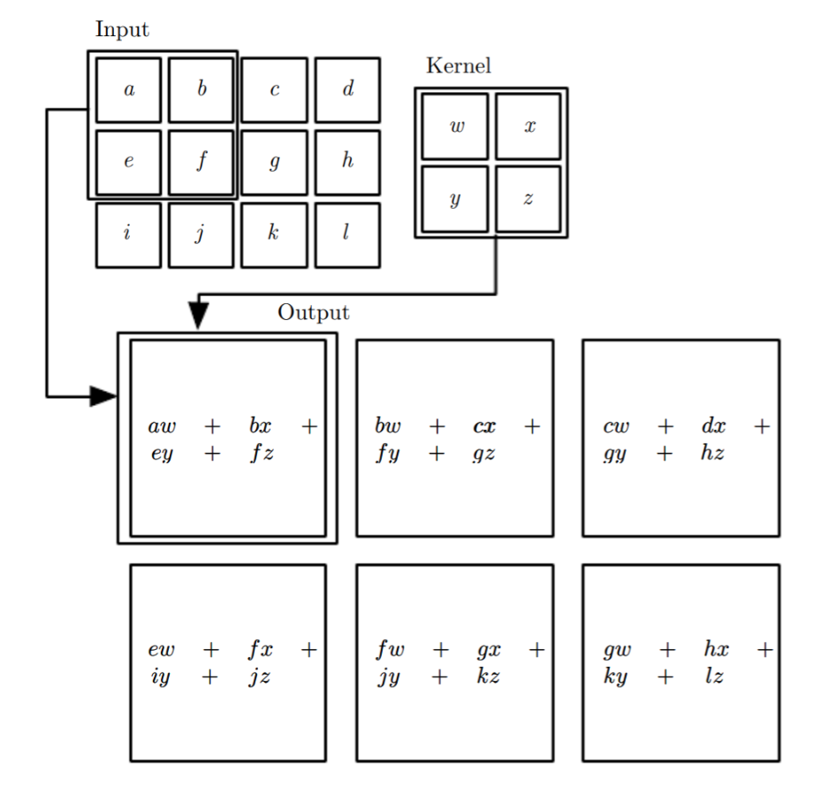
Figure 9.1, Deep Learning

Slide 42
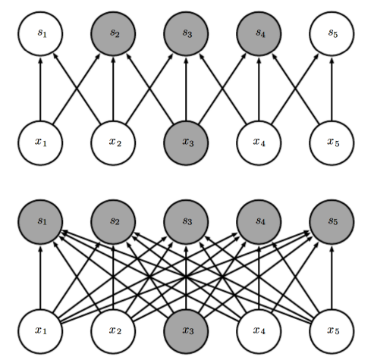
Sparse Hidden Layers
Convolutional Neural Network
Neurons no longer transmit their information to every neuron in the next layer
Figure 9.2, Deep Learning
Can also pool output of layers to learn specific mappings, e.g. max pool: pull largest number from output of set of pixels times kernel
Neural Network using
Matrix Multiplication

Slide 43
Dropout

Slide 44
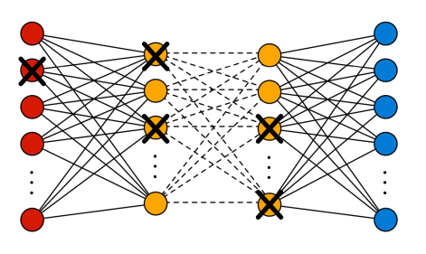
Dropout
Randomly remove certain inputs and hidden neurons from your network
Do not include in either forward passes or back propagation
By randomly changing the “dropped” features and neurons, you are training the model on batches of your data
Equivalent to bagging, since “dropout” network is subset of total network
Hailiang Du

Slide 45
Autoencoders

Slide 46
Model…your input data?
Suppose you have very high-dimensional input data
But you can uniquely and (approximately) reversibly encode that input data to much lower dimension
For example, two dimensions
Remember how hard it gets to plot things in more than 3 dimensions?
Can also correspond to a form of unsupervised machine learning
Determine what features are important to reproduce original data
PCA is a form of autoencoder (linear, specific)

Slide 47
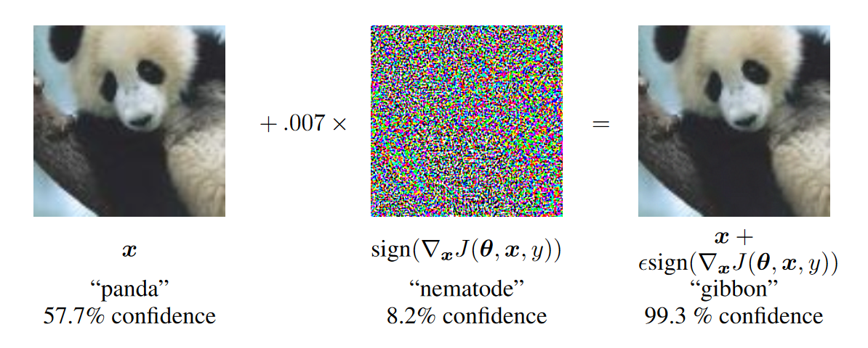
Compression
Autoencoder
Large Image File
Much Smaller
Image File
(that looks the
same to humans)

Slide 48
You Are All Models

Slide 49
You Are All Models
Practical Exercises: Training error
Coursework/Quizzes: Test error
Coursework/Quizzes: Validation error
Career: Test error
You will never stop being trained into better models
You are all wrong…
…and you are all useful!

